Slide 1
From Articles to Posts:
Sentiment and News Frame Changes in the Transition to Instagram
Social Research and Public Policy Capstone Project
Alex (Yeongseo) Chae (yc4324)
Advisor: Professor Minsu Park
Convener: Professor Stephane Helleringer

Slide 2


BACKGROUND
Social media as a news source, especially for young adults
42% adults 18-29 (US)
63% adults 16-24 (UK)
read news on social media
TikTok, Instagram news readers ↑
Platform-parting:
Republishing a news story across multiple platforms to maximize audience reach
News is adapted to fit the requirements of social media
Popularity ranking & Content moderation
Shearer, E. (2021, January). More than eight-in-ten Americans get news from digital devices.
Ofcom. (2023, July). News consumption in the UK: 2023. Author. Retrieved 2024- 04-17, from https://www.ofcom.org.uk/__data/assets/pdf_file/0024/264651/news-consumption-2023.pdf
Hanusch, F. (2017). Web analytics and the functional differentiation of journalism cultures: individual, organizational and platform-specific influences on newswork. Information, Communication and Society, 20 (10), 1571–1586

Slide 3

PLATFORM-PARTING OF NEWS
Previous literature
Preference for emotional, surprising news stories on social media
Facebook: ~½ headlines are rewritten, more question words
Facebook, Instagram: ½ of body texts are modified
Instagram: posts with personal stories have higher engagement
Extension
Large dataset on news organizations with global reach
Headline & Content modifications
Semantic meaning + Content analysis
Hase, V., Boczek, K., & Scharkow, M. (2023, September). Adapting to Affordances and Audiences? A Cross-Platform, Multi-Modal Analysis of the Platformization of News on Facebook, Instagram, TikTok, and Twitter. Digital Journalism, 11 (8), 1499–1520.
Lischka, J. A. (2021, February). Logics in social media news making: How social media editors marry the Facebook logic with journalistic standards. Journalism, 22 (2), 430–447
Lamot, K., Kreutz, T., & Opgenhaffen, M. (2022, July). “We Rewrote This Title”: How News Headlines Are Remediated on Facebook and How This Affects Engagement. Social Media+ Society, 8
Park, K., Kwak, H., An, J., & Chawla, S. (2021, April). How-to Present News on Social Media: A Causal Analysis of Editing News Headlines for Boosting User Engagement.

Slide 4
RESEARCH QUESTIONS
RQ 1.
How do headlines of news article change when an online news article is modified into an Instagram post?
RQ 2.
How does the content of news articles change when an online news article is modified into an Instagram post?

Slide 5






DATA COLLECTION
Left:
6 News Organizations
Political leaning
In English
Publish different topics
Have an official Instagram account
Allow access to articles
In order of highest Instagram followers
Center:
Right:

Slide 6
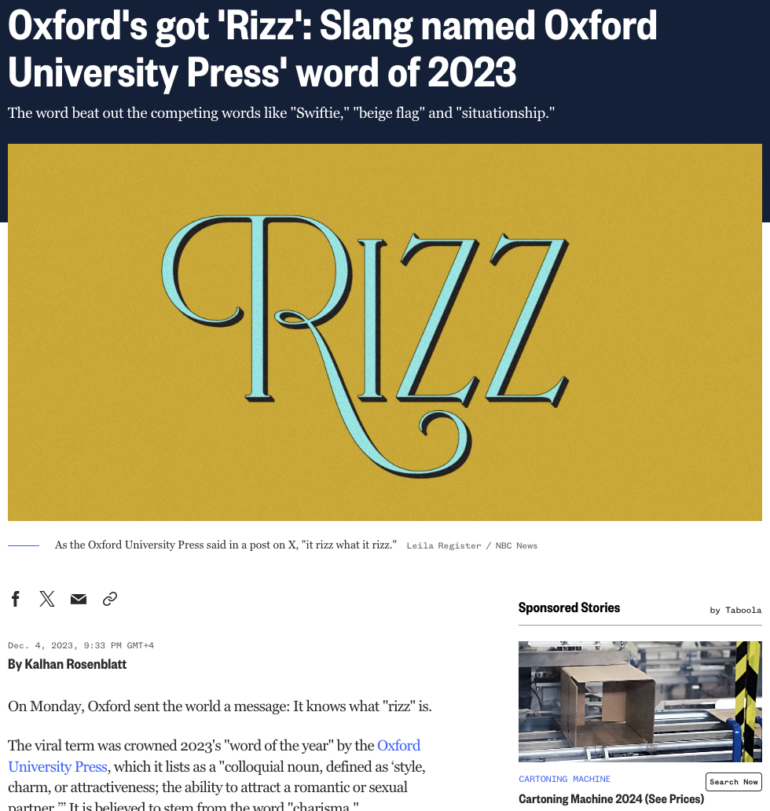
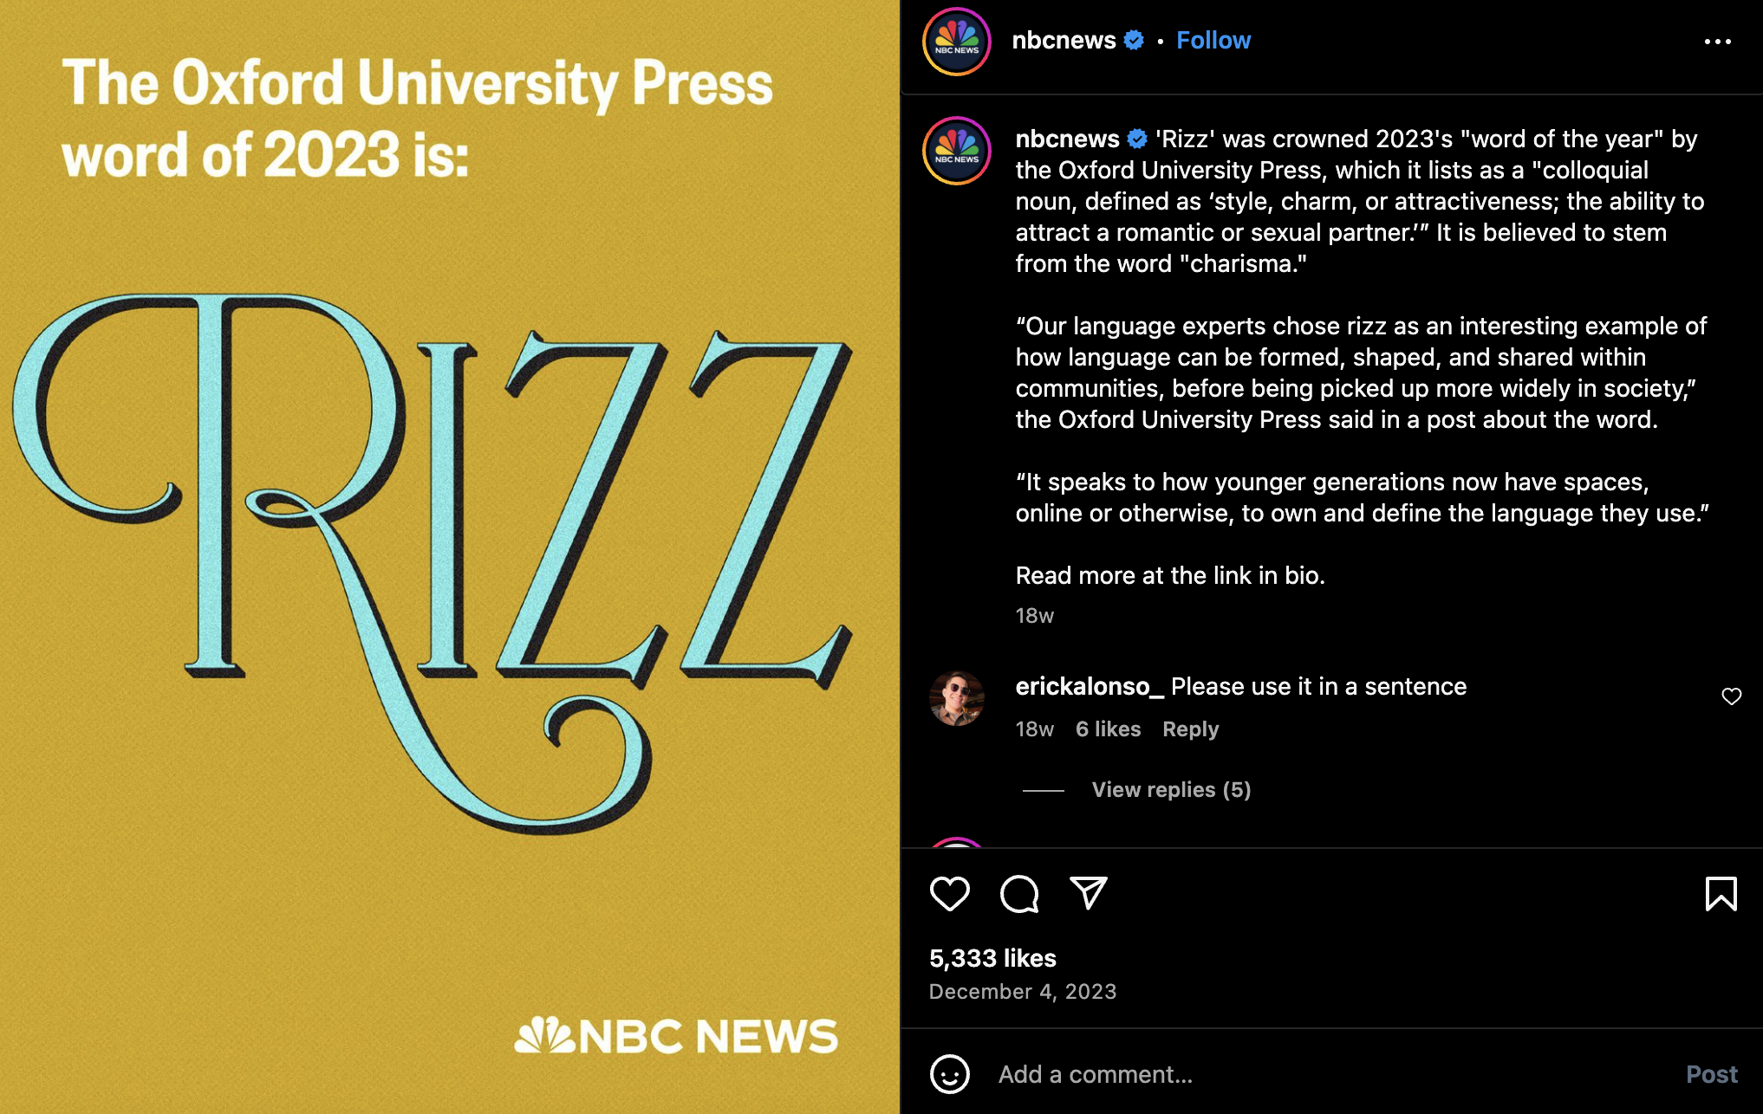
Caption
Headline
Manual extraction of headlines
Date
Date
Body text

Slide 7
19,134 article & post pairs
Political leaning | Left |  | Center |  | Right
News outlet | NBC News | New York Times | BBC News | Reuters | Washington Times | Fox News
Number of article & post pairs | 4219 | 4312 | 4647 | 462 | 1787 | 3707
Earliest date | July 17, 2020 | Mar 24, 2020 | July 17, 2021 | Jan 2, 2023 | Jan 18, 2023 | July 27, 2021
Latest date | Dec 5, 2023 | Dec 31, 2023 | Nov 13, 2023 | Oct 31, 2023 | Dec 5, 2023 | Nov 13, 2023

Slide 8
01
HEADLINE MODIFICATION
RQ 1.
How do headlines of news article change when an online news article is modified into an Instagram post?

Slide 9
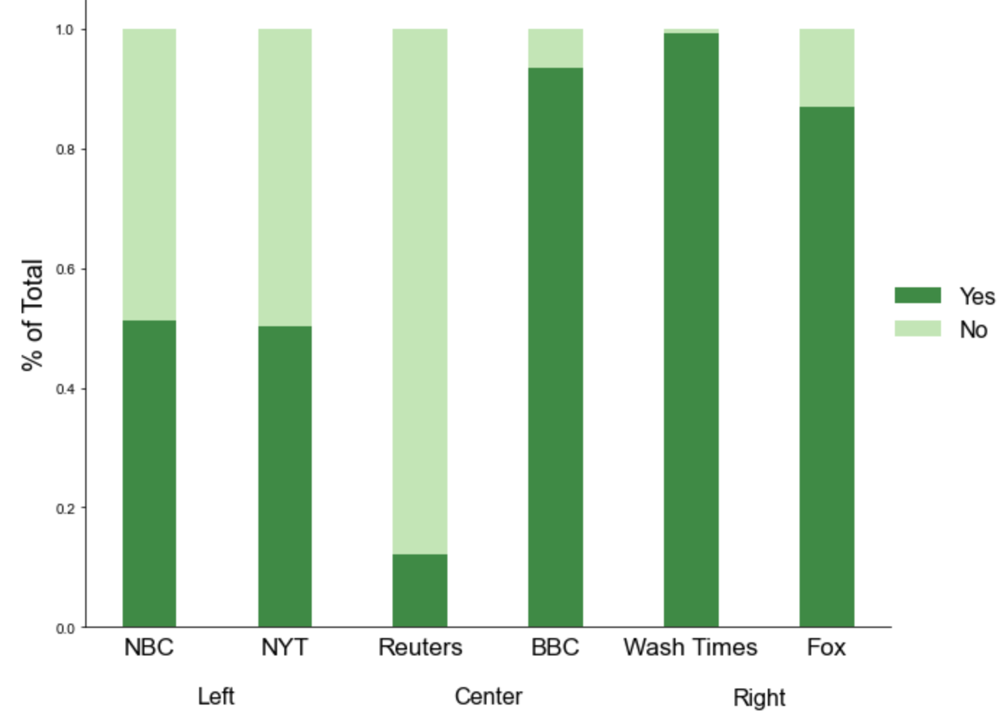
Presence of headlines
No consistent pattern across all 6 organizations
Patterns by political leaning
Most posts by right-wing organizations have headlines

Slide 10
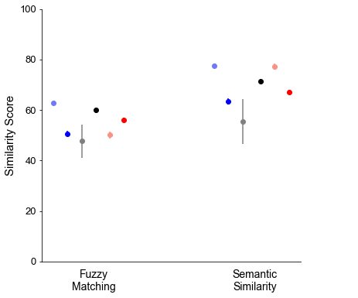
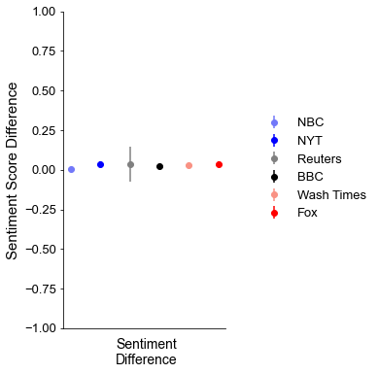

No drastic changes in headlines
Similarity of text embedding using LLM model
0: Entirely different
1: Identical
VADER (Valence Aware Dictionary and sEntiment Reasoner)
-1: Negative
+1: Positive
Edit distance

Slide 11
No drastic changes in headlines
Low sentiment difference
High similarity

Slide 12
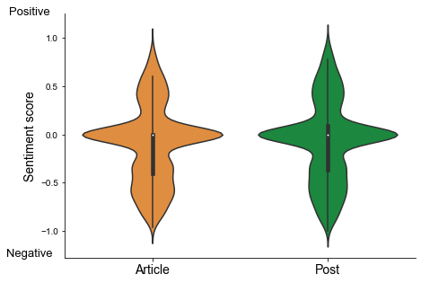
Similar sentiment distribution
* Consistent results when each news organizations were observed separately

Slide 13
02
CONTENT MODIFICATION
RQ 2.
How do content of news article change when an online news article is modified into an Instagram post?

Slide 14
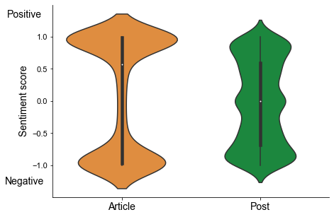
Content sentiment distribution
Article: Bimodal distribution
Very positive OR Very negative
Posts: Uniform distribution
Mean: 0.10
Mean: -0.03
* Consistent results when each news organizations were observed separately

Slide 15
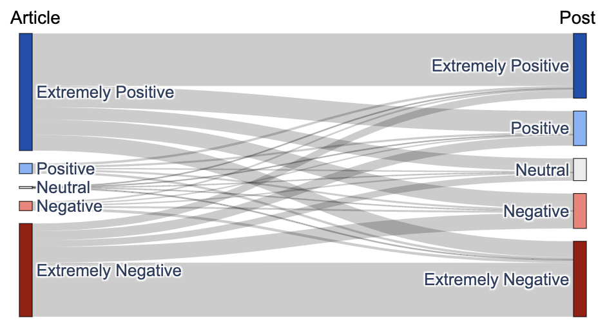

Sentiment neutralization
“Toning down” of sentiment
“Neutralization” of sentiment
More retention of negative sentiment
“Toning down”
]
Neutralization
Ext Positive -> Negative
]
Neutralization
Ext Negative → Positive
Extremely Positive: (0.525. 1]
Positive: (0.05, 0.525]
Neutral: (-0.05, 0.05]
Negative: (-0.525, 0.05]
Extremely Negative: [-1. 0.525]
“Toning down”
Unlike the common perception that social media is polarizing, I find that social media content has less intense emotions than news articles.

Slide 16
03
NEWS
FRAMING

Slide 17
News Frames
: Aspects of reality that are the most salient in a text
News articles have core information + frames to convey, interpret information
HUMAN INTEREST
RESPONSIBILITY
“Human face” to an issue
Emphasize how individuals are affected
Attribute responsibility of what happened to an individual/group/ government
ECONOMIC
CONSEQUENCES
Economic, financial
consequences of an event
CONFLICT
MORALITY
Disagreement between individuals, groups, governments
Indirect references to moral responsibility, religious tenets

Slide 18


Automated Detection of Frames
3-5 Yes/No questions to test each frame (total 20 questions)
1. Does the story provide a human example or “human face” on the issue?
2. Does the story refer to winners and losers?
(Semetko & Valkenburg, 2000)
.
.
.
Yes/No answers to 20 questions
Human validation of output
(Agreement 81.3%)
If there is a Yes to at least 1 of the questions for each frame, then the frame is deemed to be present in the text

Slide 19
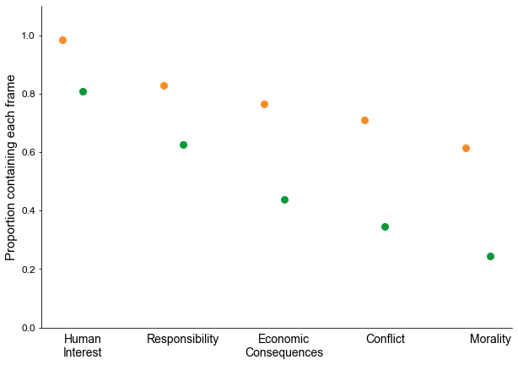
% of Articles & Posts with Each Frame
Common in articles
→ Social media prefer stories with less conflict?
Frames disappear when an article is shortened to a post
This shortening is not summarization, but a selection of information, at the expense of others
Most common in social media news
* Consistent results when each news organizations were observed separately

Slide 20
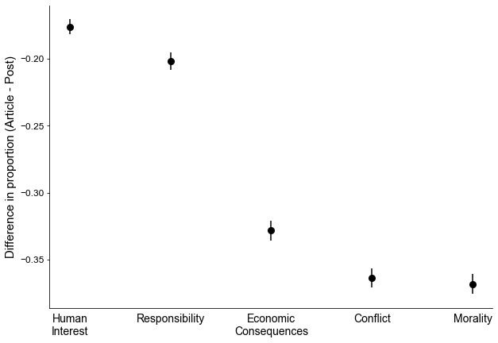
Impact of Each Frame on Sentiment Change
Frequently removed
Generally kept

Slide 21
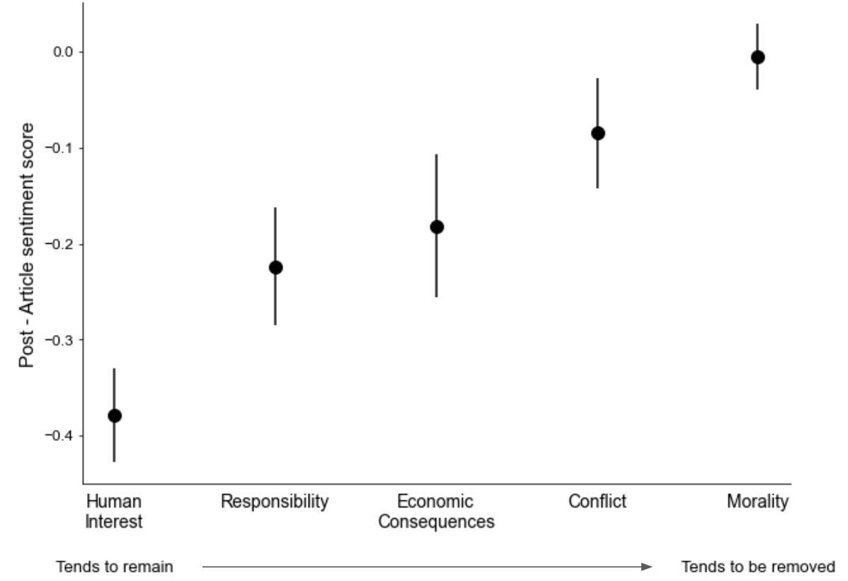
Sentiment changes when each frame is removed
Determines the emotional tone of a news story
Less important in determining the tone of a story

Slide 22
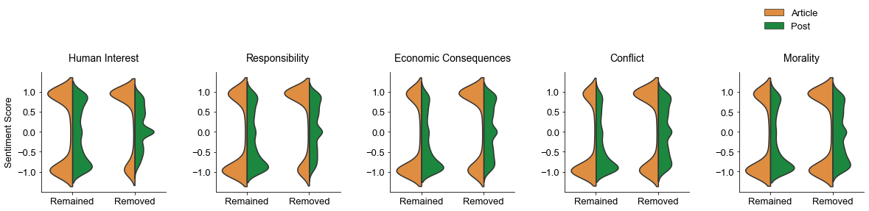
Frame Changes & Sentiment
Sentiment neutralization happens more strongly when a frame is removed
When frames remain (i.e. what is written does not change), positive sentiments are toned down while negative sentiments stay

Slide 23
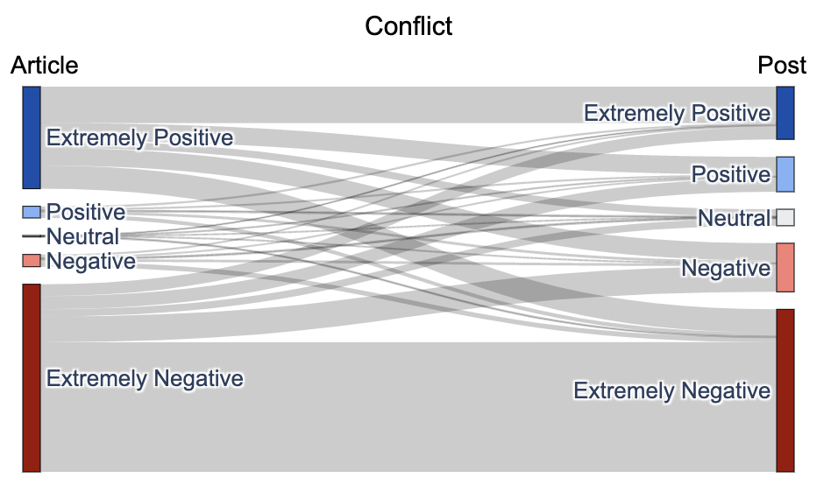
Sentiment when frames remain
Extremely positive articles become toned down/ neutral
Extremely negative articles mostly stay extremely negative

Slide 24


ONLINE NEWS ARTICLE
INSTAGRAM NEWS POST
Headlines
Content
No drastic change in headlines
Sentiment neutralized, toned down
Addition of negative sentiments
News frames change
Human interest, responsibility frames are kept
Conflict, morality frames are removed
When frames do not change, positive sentiments are neutralized, while negative sentiments remain

Slide 25
Instagram news readers are presented with a different kind of news
Sentiment neutralization
Different set of information in a news story
Further research:
What about reposts, shares of news posts?
Social media native news content?
Effect on readers’s perception of news

